Slide 1
SU2022: A Project Overview

Slide 2
Objective
Find the amount of Appendicular Lean Muscle (ALM) of an individual from a given set of measurements

Slide 3
Why?

Slide 4
Beginning Steps

Slide 5
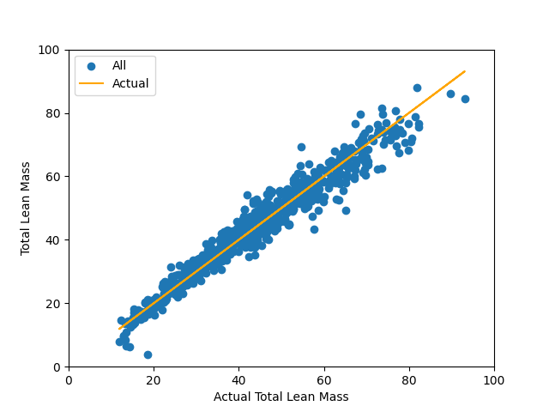
Linear Regression
We made a linear regression matrix using various multivariable regressions.
After testing it on the Total Lean Mass, it had an average relative error of 6.58% with a standard deviation of 6.34%.
Chart 1 represents what happens when we plot the actual lean mass is up against the estimated lean mass using all variables.
If a value is above the orange line, it is an overestimate.
If a value is under the line, it is an underestimate.

Slide 6
A Different Approach

Slide 7
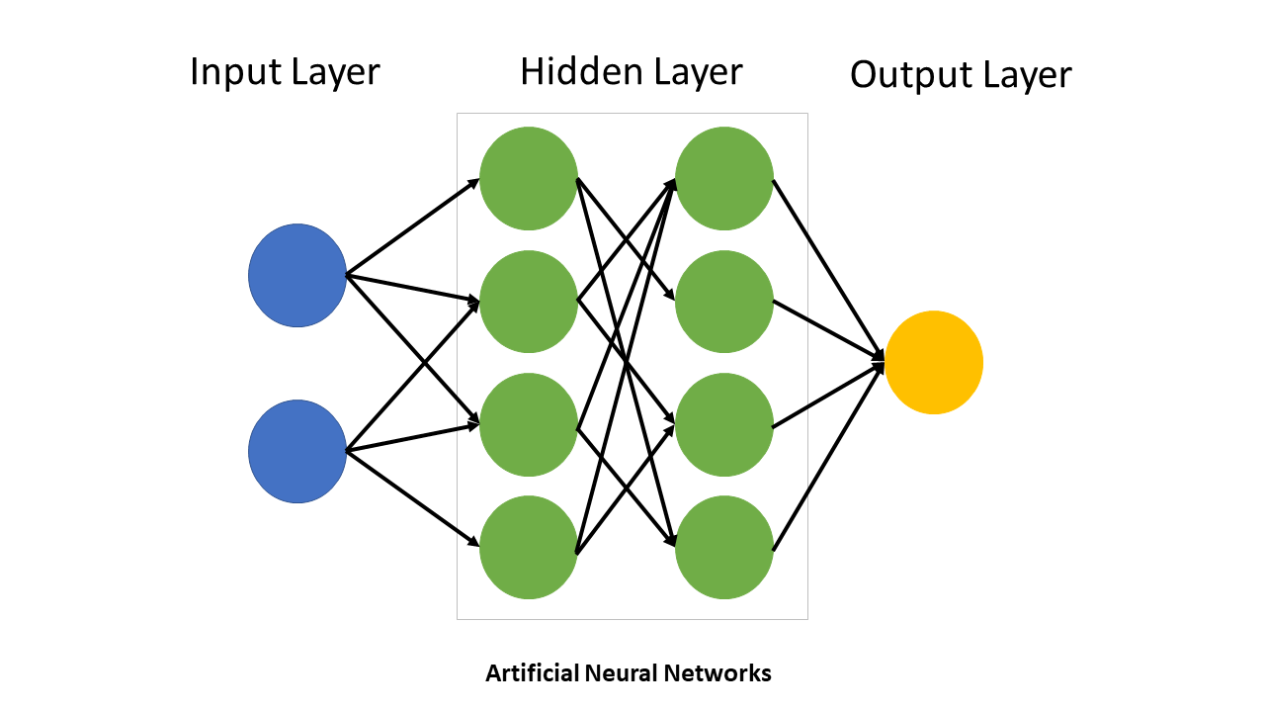
Building the Neural Network
Neural Network Layout
Input Layer: 45 variables
1st Hidden Layer: 80 nodes
2nd Hidden Layer: 50 nodes
Output Layer: 1 output
Optimizer: Adam
Criterion (loss function): MSELoss
Batch size: 64
Number of epochs: ~20000
Adam and MSELoss are common choices, but the shape of the network, batch size, and epoch size were all chosen arbitrarily.

Slide 8
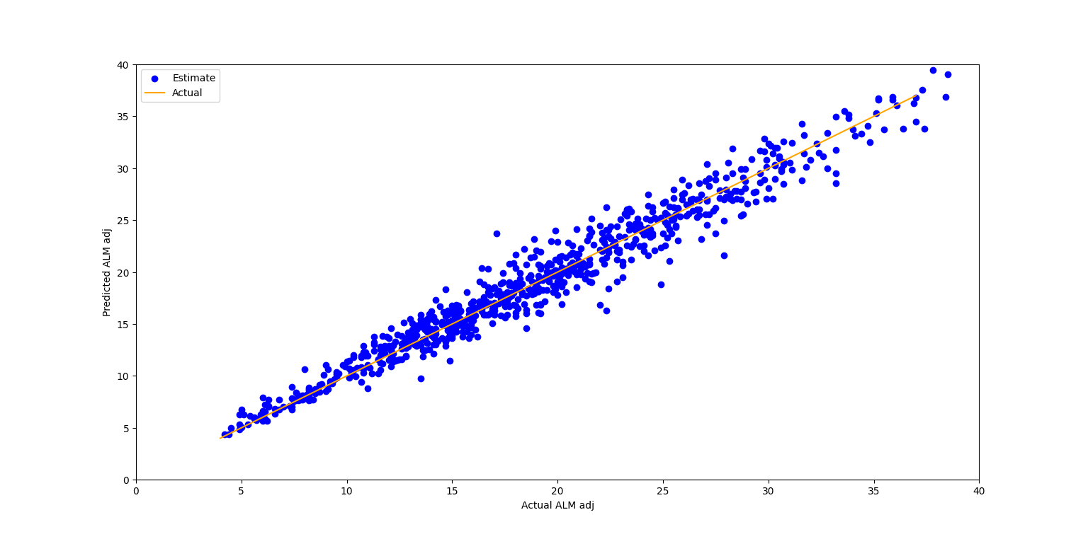
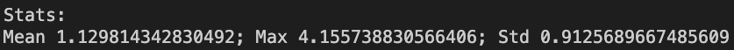
Optimizing the Neural Network
What we are doing to accomplish this
Testing different methods of filling missing values
Adjusting the number of nodes in each hidden layer.
[41, 86]
Standardizing input variables
The chart above is the predicted adjusted ALM vs the actual ALM using mean fill and layer sizes of 44, 80, 50, 1.
*** The statistics above are differences measured in kilograms

Slide 9
Problem: Incomplete Data

Slide 10
Why?
Better Training our Neural Network
For Future use of the Neural Network

Slide 11
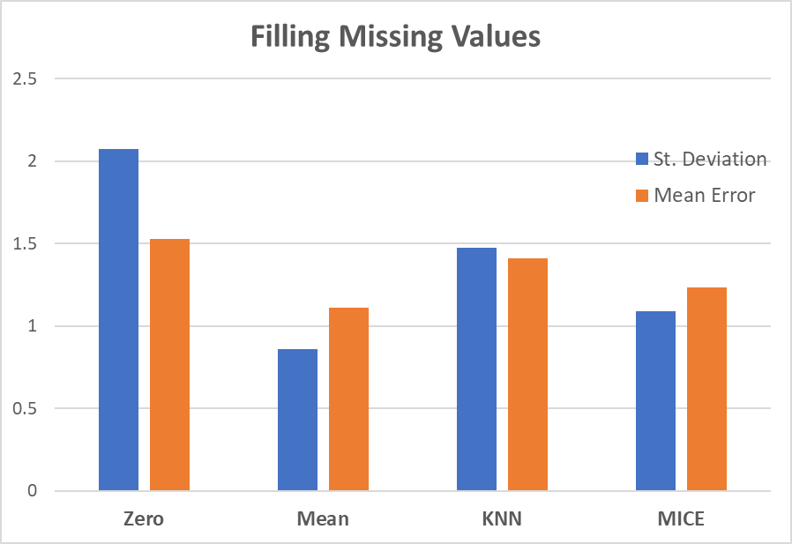
Filling Missing Values
All zeros
Mean Error: 1.530
Standard Deviation: 2.072
Mean of each feature
Mean Error: 1.109
Standard Deviation: 0.860
KNN
Mean Error: 1.408
Standard Deviation: 1.474
MICE (Multivariate Imputation by Chained Equations)
Mean Error: 1.232
Standard Deviation: 1.091
Gradient of the Loss Function
The results were not that good. The majority of the time, it would guess extremely large values or negative values.

Slide 12
Future Plans

Slide 13
Future Neural Network Optimization
Future Adjustments to the Neural Network
Try different OPTIMIZERS
Similar to Adam: AdamW, AdamX, NAdam, RAdam
Gradient Descent: SGD, ASGD
Backpropagation: Rdrop
Try different NUMBER OF HIDDEN LAYERS
Try different EPOCH & BATCH SIZES
Epoch: 100 - 2000
Batch sizes: 16 - 128
Filling Missing Values for More Complete Training
Test fill methods with a trained NN

Slide 14
Questions?

